Slide 1
Structured Approach to Data Analytics Sprint 1 Project Turing College Data Analytics Program

Slide 2
Project analysis slide 2
Structured Approach to Data Analytics
6
1
ACT
ASK
5
2
SHARE
PREPARE
4
3
ANALYZE
PROCESS

Slide 3
Project analysis slide 3
ASK
How many hours do I spend on various social media applications on my phone daily ?
How do I reduce it?
How do I keep my total screen time below 4 hours daily?

Slide 4
Project analysis slide 3
PREPARE
Phone applications and number of hours spent using each application daily.
Phone applications and number of hours spent using each application weekly.
Collected Data for 10 applications and their daily usage in minutes for 1 week.
Collected data by manually entering into cells from my phone from Digital well-being application.
DATA NEEDED

Slide 5
Project analysis slide 3
PROCESS
The data processing involved:
Storing the data on Google Sheets and saving
Having a uniform unit across all entries (daily usage time in hours and minutes to minutes) to ensure correctness.
Ensuring there were no null values ascertain completeness.
Ensuring the right data types

Slide 6
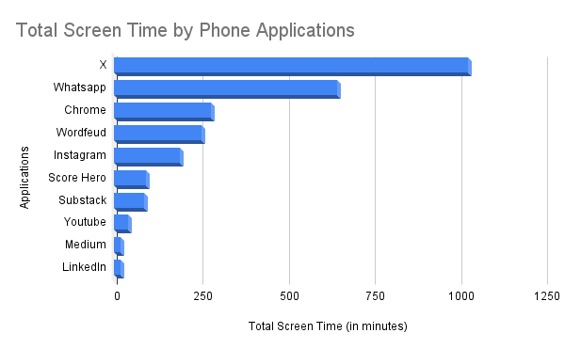
Project analysis slide 3
ANALYZE
Data was analyzed in Google Sheets
A Pivot Table and Pivot Chart was created to visualise findings
Data shows observations for 1 week.

Slide 7
Project analysis slide 3
SHARE
Findings
X and Whatsapp are the most used applications
5 applications contribute the most screen time

Slide 8
Project analysis slide 3
ACT
X and Whatsapp are the most used applications. Limiting the time spent on these two apps will reduce overall screen time.
Limit time spent on each application to 1hr max by setting timers.

Slide 9
Project analysis slide 5
Conclusion
The problem to be solved was screen time reduction
Data was collected from my Digital Well-being application monitoring screen time for each app.
These data was analyzed and X and WhatsApp contribute the most to my screen time.

Slide 10
Thank You

